Slide 1
Coon Qualifying Exam Question #5 Part #1
Tim Coon
3 March 2015

Slide 2
Overview
Review Q5 P1 original problem setup
Modified problem setup
Equations of Motion Derivation
Simulation
Results
Conclusions
Future Research

Slide 3
Review Q5 P1 original problem setup
Circular mirror
Right side at principle axis

Slide 4
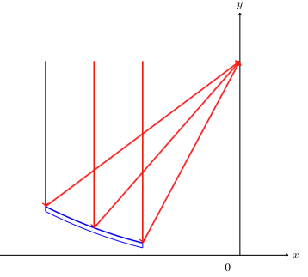
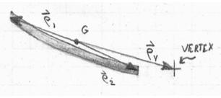
Modified problem setup
Off-axis parabolic mirror segment

Slide 5
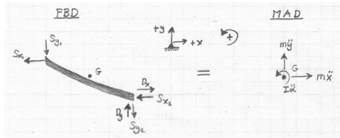
Equations of Motion Derivation
FBD = MAD
Kinetic and Kinematic Equations
Centroid Location

Slide 6
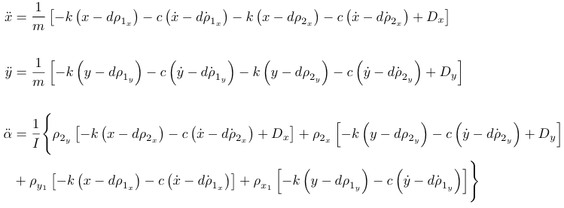
Equations of Motion Derivation

Slide 7
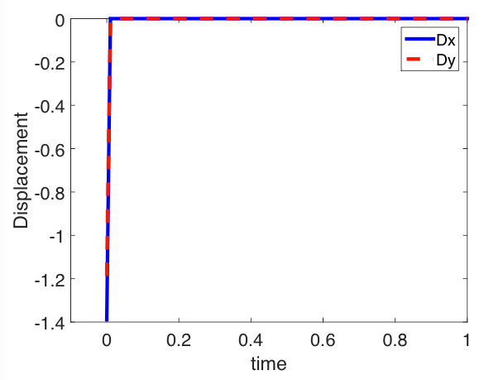

Simulation
MATLAB random number generator for impulse input disturbance given r₀ and σ₀.

Slide 8
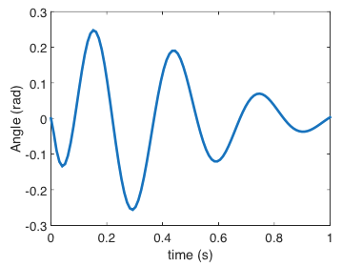
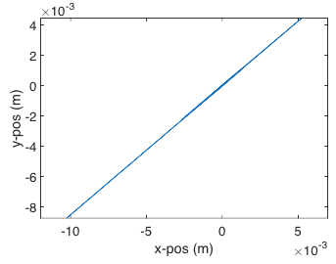
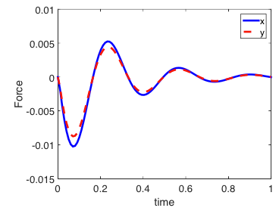
Simulation
For each realization of the disturbance input, the deterministic solution is found by numerical integration of the state equations in ode45()

Slide 9
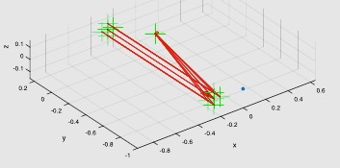
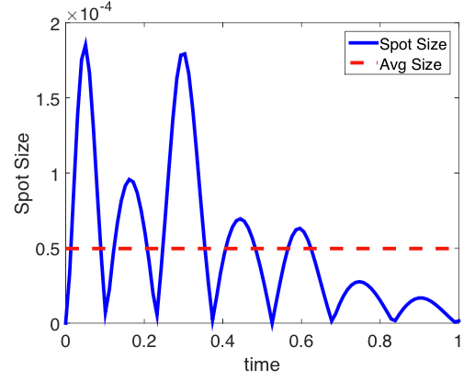
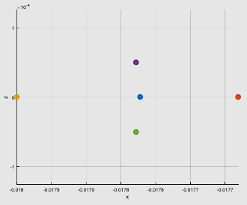
Simulation
Output metric is the average maximum spot size radius. The detector plane spot diagram is found using an exact raytrace of the chief ray and the marginal rays. The maximum spot size radius is the max of the Euclidean norms between the chief ray and each of the marginal rays.

Slide 10
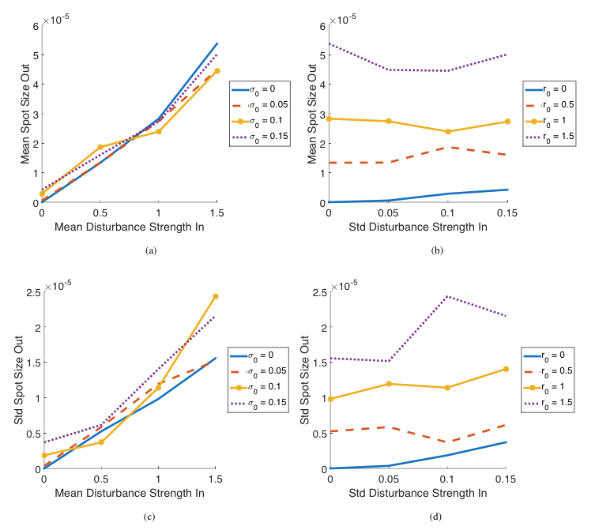
Simulation
Monte Carlo Simulation
For a given disturbance distribution, (r₀, θ₀), generate a number of output realizations and calculate the output distribution parameters, (r, θ), assuming Gaussian distribution.
Repeat for all combinations of (r₀, θ₀) and plot the relationship between input and output distributions.
Only seven realizations were used to generate the plots herein, so trends are not well-represented, but are recognizable nevertheless.

Slide 11
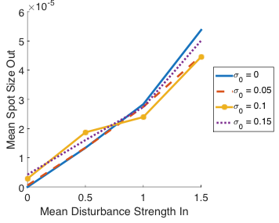
Results (1/4)
It makes sense that a larger disturbance force would cause a larger spot size radius. Because we are comparing the means, the change in standard deviation should have little effect except at the origin.

Slide 12
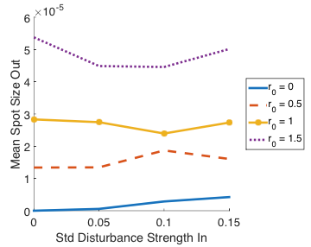
Results (2/4)
The standard deviation of the input force has little effect on the mean spot size except at r₀ = 0. This helps to validate the Gaussian assumption for the output distribution.

Slide 13
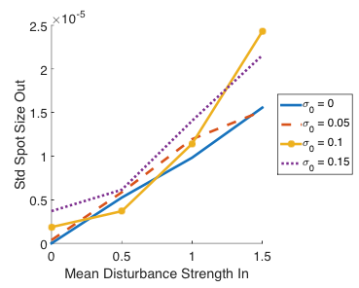
Results (3/4)
Intuitively, if the disturbance force is greater, then the variation on the output will also have a greater magnitude. This would be a horizontal line if we took the standard deviation to be the percentage of the average spot size radius.

Slide 14
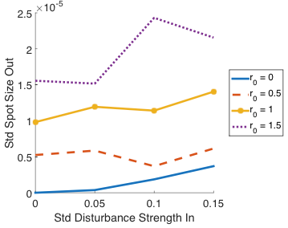
Results (4/4)
The standard deviation of the output increases with the standard deviation of the input, as expected.

Slide 15
Conclusion
The results of MCS validate the models and the Gaussian distribution assumption
These analysis tools may be utilized for future research

Slide 16
Future Research
Implementation of alternate theory such as polynomial chaos expansion to make more complex systems tractable. The simple Monte Carlo Simulation presented here required more than 36 hours to execute using MATLAB.
Incorporate existing analysis software such as Zemax.
Optimize the design of CTEx telescope by considering the change in output distribution as a result of changing the system parameters.
In the end, a methodology will be established whereby an optical system (this one passively controlled) is designed to meet required limits on output distribution and estimate of the model uncertainties from external disturbances, system parameters, and measurements.
Some comparison must then be made to assess the value of this stringent analysis method against current methods (e.g. static, quasi-static, frequency analysis, sensitivity analysis).

Slide 17
Next Time…
Q5P2 – Add a controller to the system
Q5P3 – Analyze added surface roughness

